Slide 1
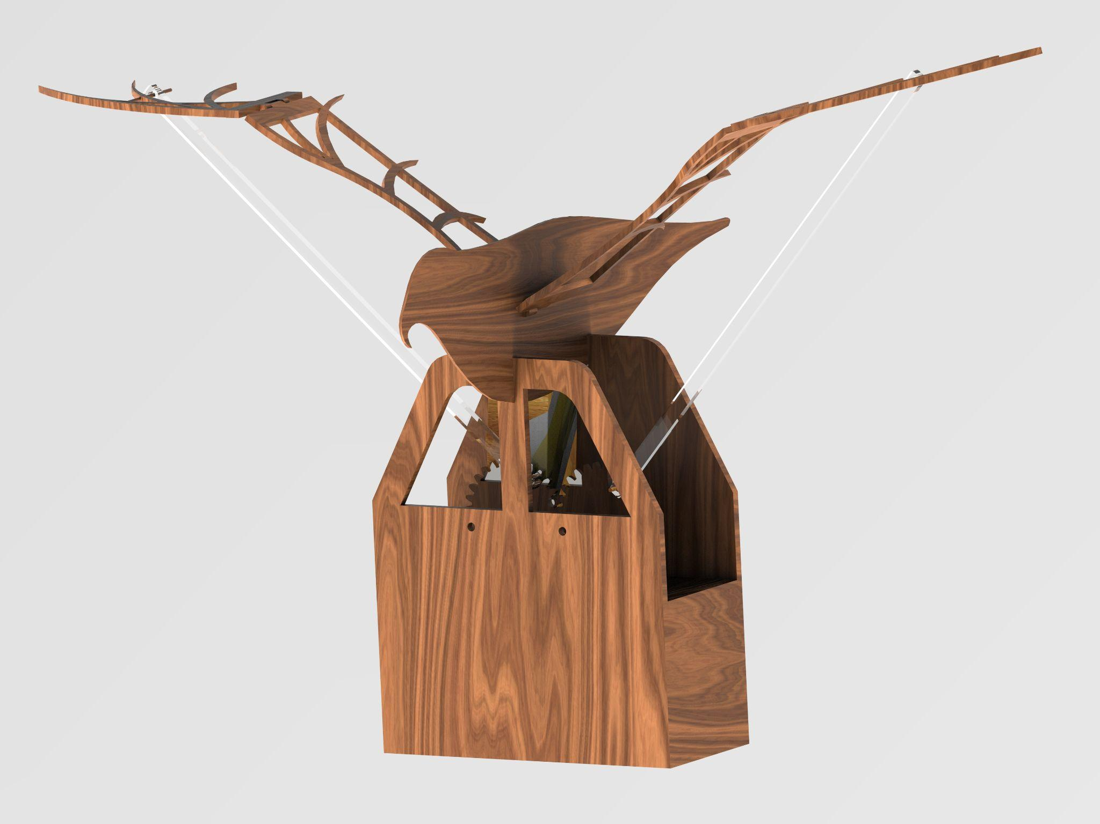
Spread your wings
Gesture controlled bird-like robot
Group 3
Atocha, Hala, Rimmie & Yawen
Notes:
motivation of your idea, the general realization/approach/functionality, problems and possible improvements.

Slide 2


Slide 3
Background
Components
Gesture controlled bird-like robot
The project involves creating a bird-like robot with visual and audio effects, which can be controlled by hand gestures.
IMU sensor, DC motor, arduino UNO, Arduino Nano, Breadboard, L298N, HC-06 Bluetooth module, HM10 BLE 4.0 Module, wires
Motivation
Dancers and stage art
People with disabilities

Slide 4
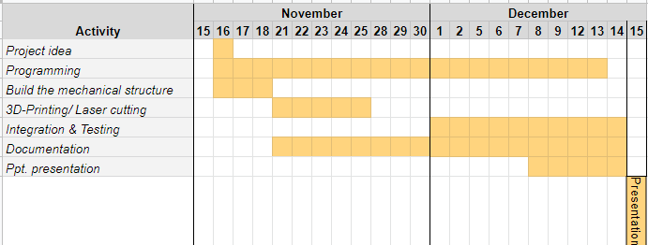
Approach
Notes:
our first step was breaking down the project into smaller more manageable tasks and determining both the resources and the timeline needed to complete each task.

Slide 5
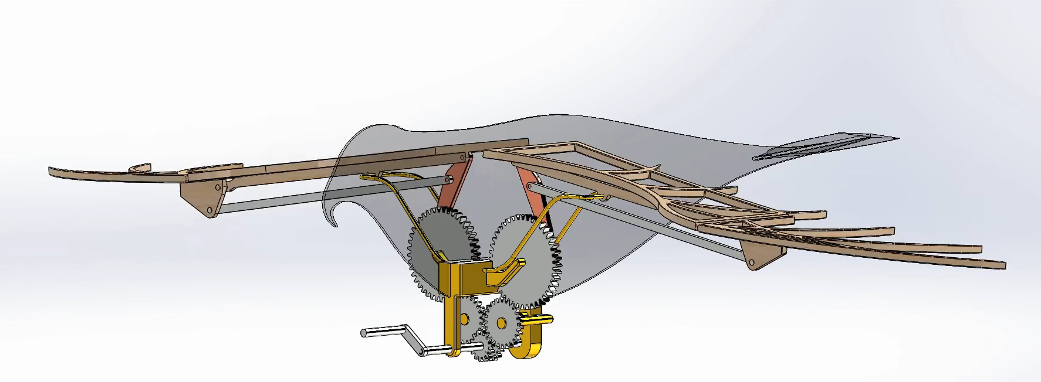
Simulation of the bird’s movement
Notes:
One of the first tasks that we had after choosing the project idea was creating a 3d- model using CAD program, Solid edge. And here you can see a simulation of the birds movements while moving the hand with a constant speed:
We’re going to talk more about the problems that this iteration had at the end of this presentation

Slide 6
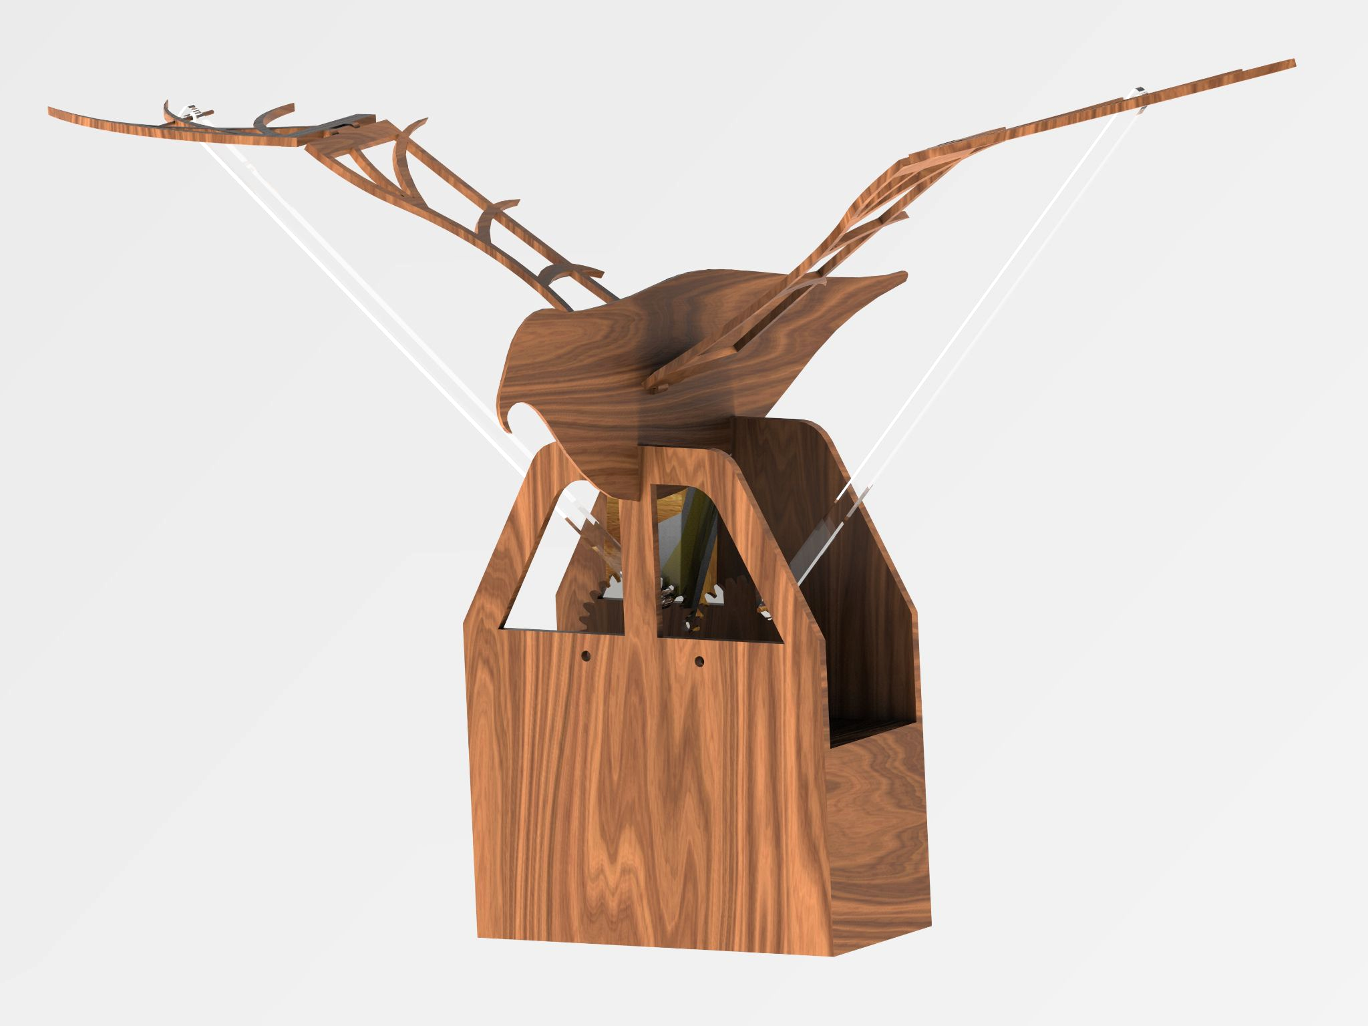
CAD

Slide 7
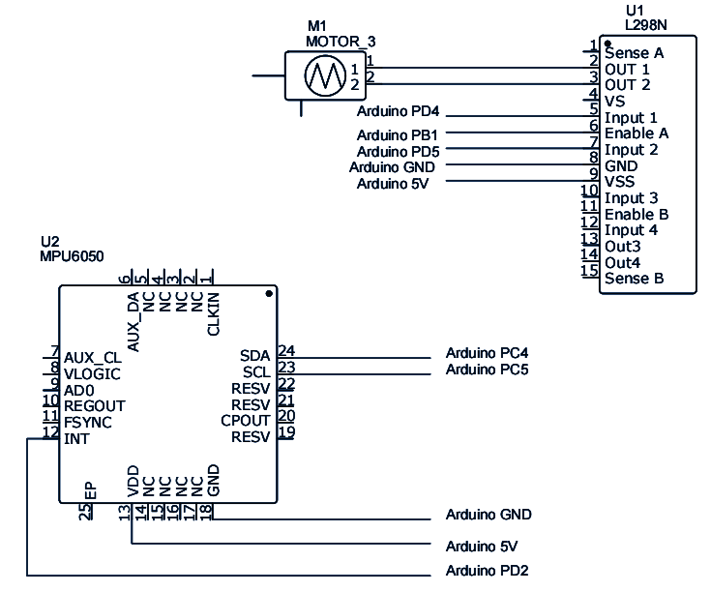
Electronic Design

Slide 8
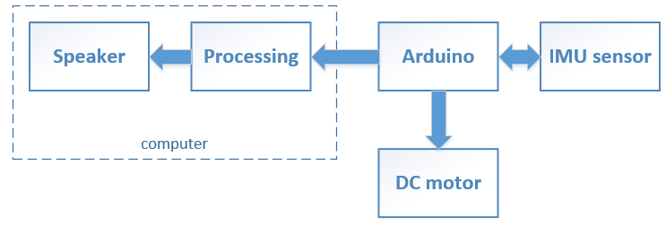
Block diagram

Slide 10

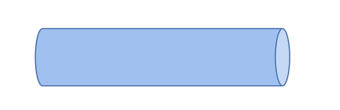
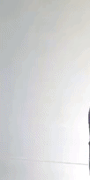
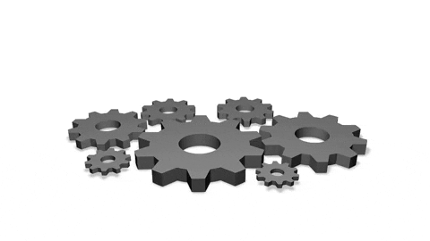
No
DELAY
short
Arduino
Processing
long

Slide 11
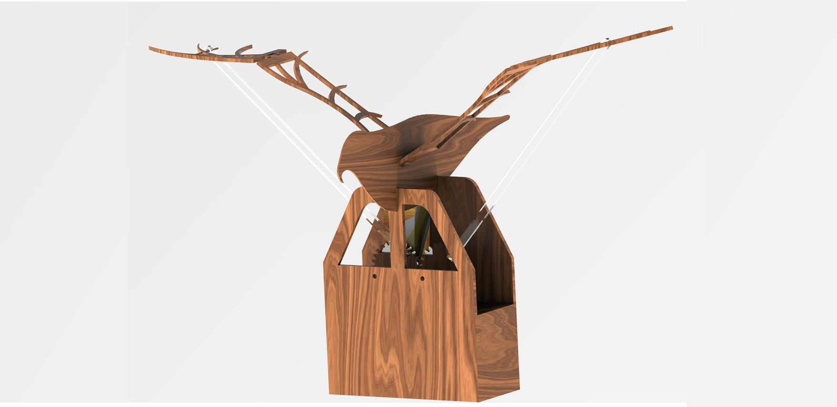
Functionality wired
Power supply
LM298
Arduino UNO
Power supply
DC motor
IMU- gyroscope

Slide 12
Functionality - wireless
IMU- gyroscope
nRF - Transmiter
Arduino Nano
Power supply
Power supply
LM298
Arduino UNO
nRF - Receiver
Power supply
DC motor

Slide 13
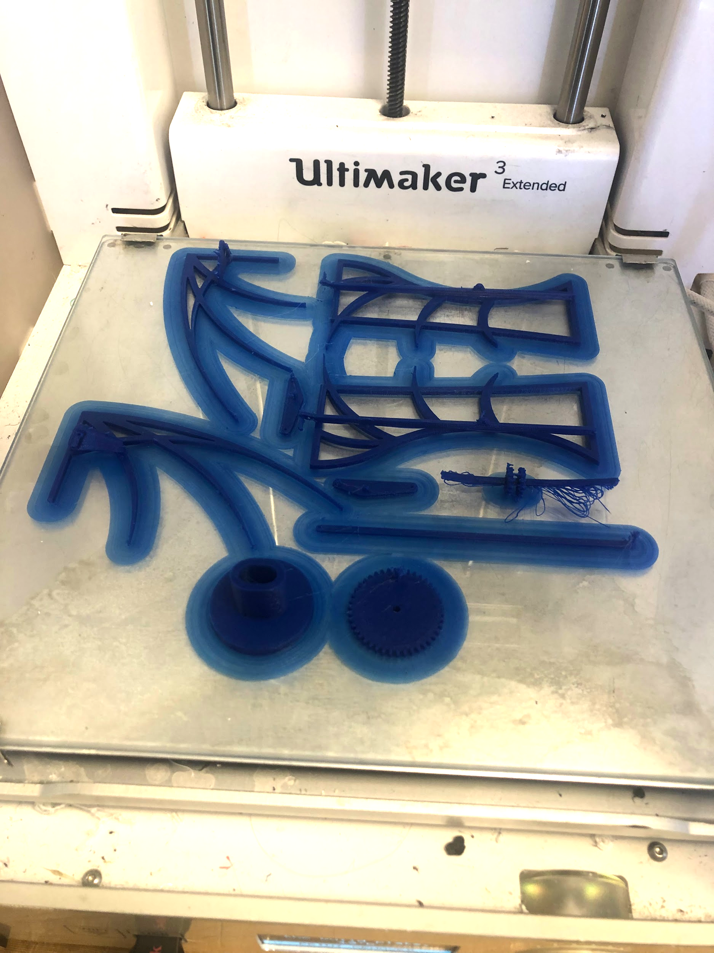
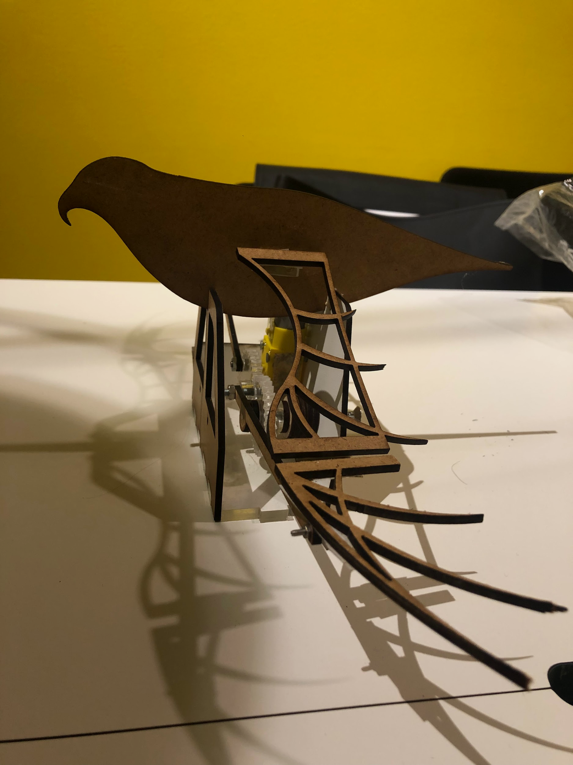
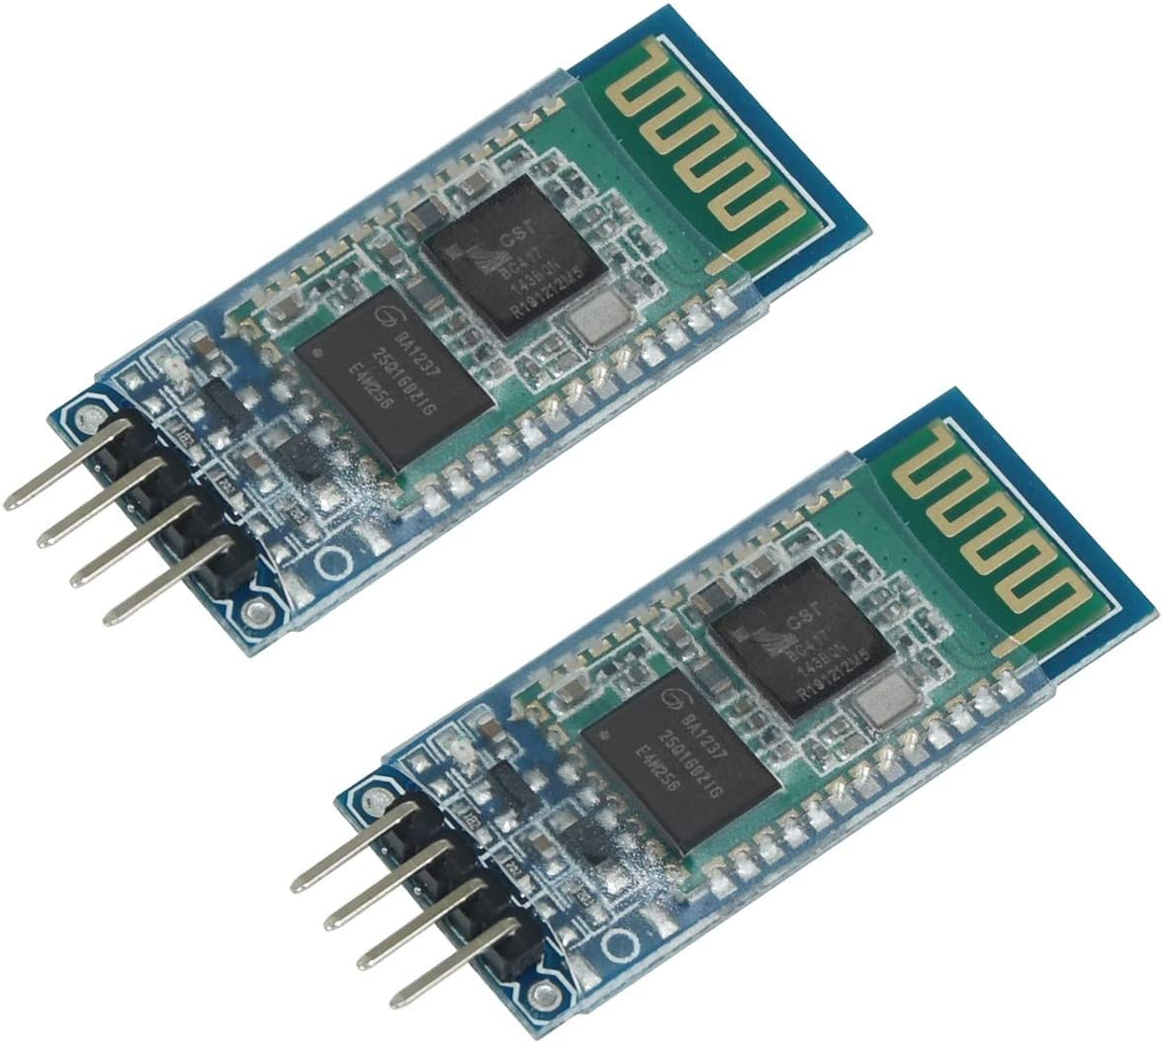
Problems and possible improvements
Notes:
mention the lipstick!

Slide 14
Problems and possible improvements
Arbete framöver
Dimensioning and connection of different parts
Limited choice of materials for prototyping.
Reducing friction in the gears for smooth movement of the wings
Availability of the machines
Improvements
Robust prototyping
Telecom algorithm:
delay can be replaced by downsampling/smoothing

Slide 15
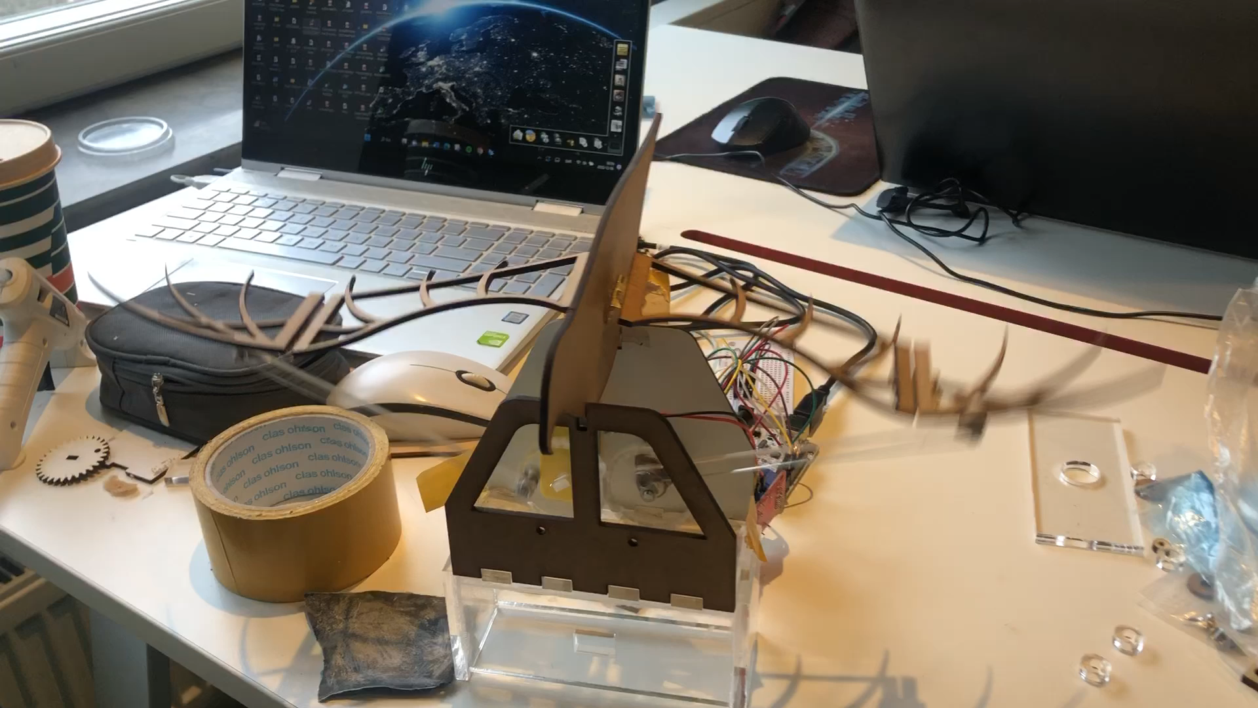
Blooper

Slide 16
Spread your wings
Gesture controlled bird-like robot
Group 3
Atocha, Hala, Rimmie & Yawen
Notes:
motivation of your idea, the general realization/approach/functionality, problems and possible improvements.

Slide 17
Kinetic Art Video

Slide 18
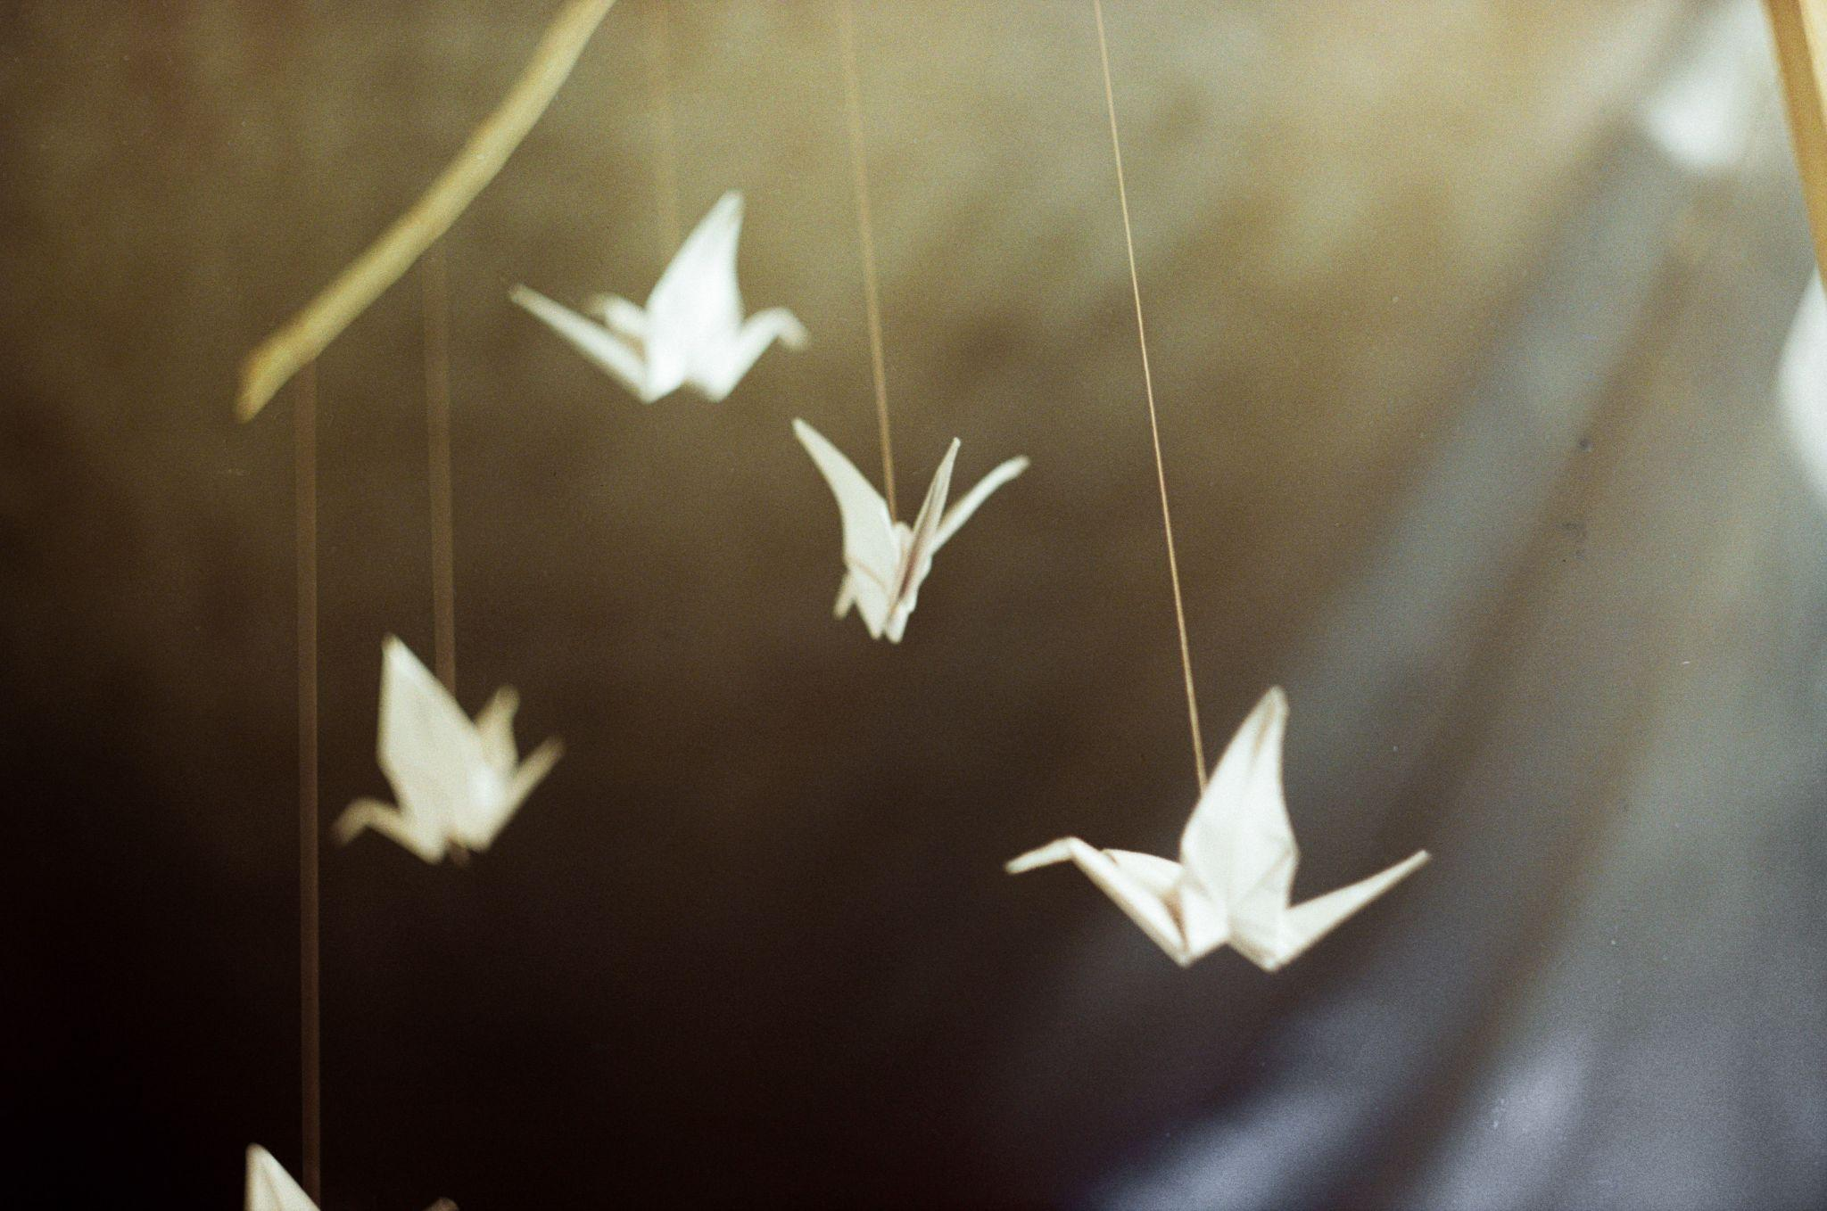
Kinetic Origami
Group 3
Notes:
motivation of your idea, the general realization/approach/functionality, problems and possible improvements.

Slide 19
Kinetic Origami
Group 3

Slide 20
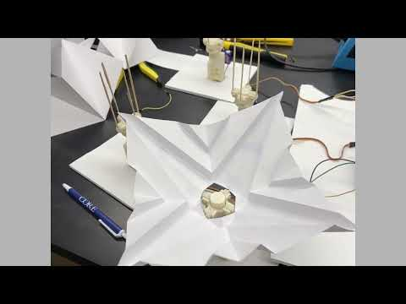
Inspiration

